Slide 1
Module – 2 Distributed Operating Systems

Slide 2
Distributed Operating Systems
The term distributed system is used to describe a system with the following characteristics:
It consists of several computers that do not share a memory or a clock.
The computers communicate with each other by exchanging messages over a communication network.
Each computers has its own memory and runs its own operating system.
The resource owned and controlled by a computer are said to be local to it.

Slide 3
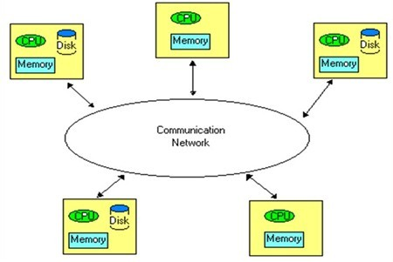
Architecture of a Distributed Systems

Slide 4
Advantages of Distributed Systems
Resource Sharing
A computer can request a service from another computer by sending a request to it over the communication network.
Hardware and software resources can be shared among computers.
Eg: a printer, a compiler, a text processor, a database at a computer can be shared with remote computers.
Enhanced Performance
Capable for providing rapid response time and higher system throughput.
Many task can be concurrently executed at different computers.
Can employ a load distributing technique to improve response time.

Slide 5
Advantages of Distributed Systems
Improved Reliability and Availability
Few components of the system can fail without affecting the availability of the rest of the system.
Through the replication of data (files and directories) and services, distributed systems can be made fault tolerant.
Modular Expandability
New software and hardware resources can be easily added without replacing the existing resources.

Slide 6
Issues in Distributed Operating Systems

Slide 7
Issues in DOS
Some Important issues are:
Unavailability of up-to-date global knowledge
Naming
Scalability
Compatibility
Process synchronization
Resource management
Security
Structuring of the operating system

Slide 8
Issues in DOS
Unavailability of up-to-date global knowledge
In case of shared memory system, up-to-date state of all the processes and resources are known.
Due to the unavailability of a global memory and a global clock, it is practically impossible for a computer to collect up-to-date information about the global state of the distributed computing system.
A computer does not know the current and complete status of the global state.
Absence of a global clock arises the question of how to order all the events that occur at different times at different computers present in the system.
Temporal ordering of events is a fundamental concept in the design and development of distributed systems.

Slide 9
Issues in DOS
2. Naming
•
•
Naming are used to refer to objects.
Objects that can be named in computer systems include computers, printers, services, files and users.
Eg: Name Service. [Store names and their physical addresses are used for mapping names to their addresses]
In distributed system, the directories may replicated and stored at different locations.
Algorithm depend on structure of names.
Method of naming objects.
•
3. Scalability
•
•
Systems grow with time.
The techniques used in designing a system should not result in system unavailability or degraded performance when growth occurs.

Slide 10
Issues in DOS
Compatibility
Refers to the notion of interoperability among the resources in a system.
Three levels of compatibility that exist in distributed systems are:
Binary level – all processors execute the same binary instruction, even though the processors may differ in performance and in input-output. Distributed system cannot include computers with different architectures.
Execution level –if the same source code can be compiled and executed properly on any computer in the system
Protocol level – if all system components support a common set of protocols. Individual computers can run different Operating Systems.

Slide 11
Issues in DOS
Process synchronization
Is difficult because of the unavailability of shared memory.
Resource management
Concerned with making both local and remote resources available to users in an effective manner.
Users should be able to access remote resources as easily as they can access local resources.

Slide 12
Issues in DOS
Security
The security of a system is the responsibility of the operating system.
Two issues are authentication and authorization
Authentication is the process of guaranteeing that an entity is what it claims to be.
Authorization is the process of deciding what privileges an entity has and making only these privileges.
Structuring
Defines how various parts of the operating system are organized.

Slide 13
Communication networks

Slide 14
Communication networks
All the computers in a distributed system are interconnected through a communication network.
A computer can exchange messages with other computers and access data stored at another through this network.
Communication networks are classified into
Wide Area Networks
Local Area Networks

Slide 15
1. Wide Area Networks (WANs)
Used to interconnect various devices (such as computers and terminals) spread over a wide geographic area that may cover different cities, states and countries.
Also referred to as Long Haul Networks.
The communication facility in a WAN consists of switches that are interconnected by
communication links, which are established through telephone lines, satellites,
microwave links, or any combination of the three.
WANs employ a technique known as point-to-point or store-and-forward where data is transferred between computers through a series of switches.
Switches are special purpose computers responsible for routing data from one point to another through an appropriate path while avoiding network congestion.
A path or portion of a path become congested due to heavy data communication through that path or due to limited bandwidth.

Slide 16
1. Wide Area Networks (WANs)
The data being communicated in a WAN can be lost for any of the following reasons:
Switch crashes
Communication link failure
Limited buffer capacity at switches
Transmission Error

Slide 17
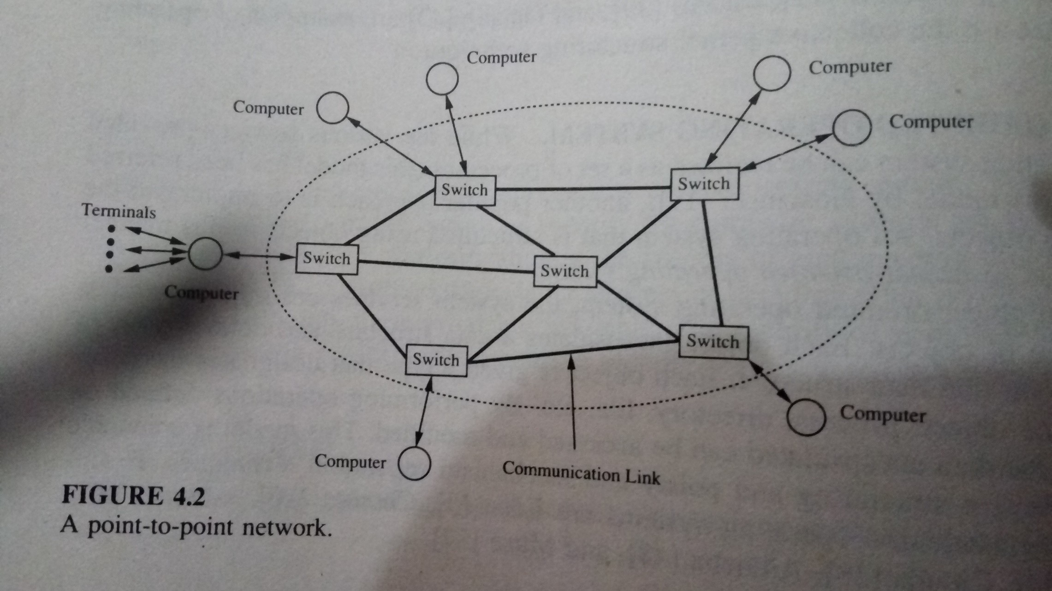
1. Wide Area Networks (WANs)

Slide 18
Utilizing communication networks - modes
The communication network can be utilized in one of the following two modes:
Circuit Switching
Packet Switching
Circuit switching
A dedicated path is established between two devices wishing to communicate, and the path remains intact for the entire duration in which the two devices communicate.
The path is broken when one side terminates the conversation.
Example – telephone system

Slide 19
Utilizing communication networks - modes
Packet switching
A connection established between the source device (terminal or computer) and its nearest switch.
The data or message to be communicated is broken down into smaller units called packets, with each packet containing the address of the destination.
The packets are then sent to the nearest switch.
These packets are routed from one switch to another switch in the communication network until they arrive at the switch connected to the destination device.
A communication path(switches or links) is not reserved by any two devices wishing to communicate, but rather is dynamically shared among many devices on a demand basis.
The network can be shared between many devices.

Slide 20
The ISO OSI Reference Model
WANs must interconnect heterogeneous types of equipment (Computers, Printers etc).
These equipment may differ from each other in their speed, word length, information representation or in many other criteria.
To communicate in heterogeneous environment, the ISO OSI reference model provides a framework for communication protocols.
It organizes the protocols as seven layers and specifies the functions of each layer.
In this model, user programs run in the application layer.

Slide 21
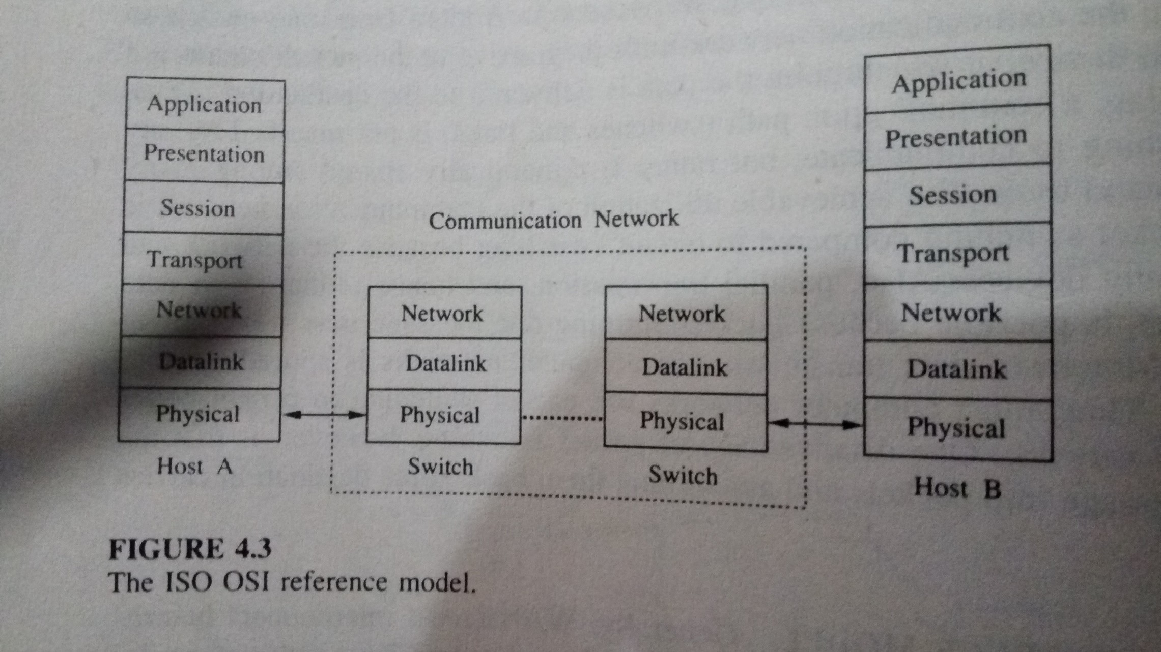
ISO OSI reference model

Slide 22
The ISO OSI Reference Model
When an application program at computer A wants to send a message to an application program at computer B, the chain of events are:
The application layer of A passes the message down to presentation layer.
The Presentation layer transforms the data, add a header containing some control information to the message and passes to session layer.
The session layer adds its own header to the message and passes to next layer.
This continue until the message reaches the physical layer of Computer A.
The physical layer on A transmits the raw data bits into physical layer running at computer B. (Message is routed to B through various intermediate switches).
At computer A, after receiving message, performs the necessary processing identified by the header and passes on to the next layer.
This continues until the message reaches the destination.

Slide 23
The ISO OSI Reference Model
The ISO OSI model does not specify how the layers should be implemented.
Every layer is aware only the protocols and header formats of its own.
It does not understand the header or the protocols used by other layers.
Each layer is independent, so any layer can change its protocol without affecting other layers.

Slide 24
2. Local Area Networks (LANs)
A LAN is a communication network that interconnects a variety of data communication devices within a small geographic area.
Characteristics of LANs
High data transmission rates.
The geographic scope is small, generally confined to a single building or several buildings (eg: college campus)
Low transmission error rate.

Slide 25
Network topologies of LAN
Widely used network topologies of LAN are:
Bus
Tree
Ring
The communication media can be coaxial cable, twisted pair wire or optical fibre.

Slide 26
Bus / Tree topology
In bus topology, the communication devices transmit data in the form of packets where each packet contains the address of the destination and a message.
A packet propagates throughout the medium, the bus, and is available to all other devices, but is received by the addressed device.
In the bus topology, all the devices connected to the LAN are allowed to transmit at any time.
Since all the devices share a common data path (bus), a protocol to control the access to the bus is necessary.
A tree topology LAN is obtained by interconnecting many bus topology LANs to a common bus.
Protocols to control access to the bus are,
CSMA/CD (Carrier Sense Multiple Access with Collision Detection) protocol
Token bus protocol

Slide 27
Bus / Tree topology
CSMA/CD (Carrier Sense Multiple Access with Collision Detection) protocol
A device wishing to transmit listens to the medium to determine whether another transmission is in progress.
If so, the device waits for a random amount of time before trying again.
If no other transmission is in progress, the device starts transmitting data and continues to listen to the medium while it is transmitting.
If another device starts transmitting simultaneously, the two transmission collide.
If a collision is detected, a short jamming signal is transmitted over the bus to inform all the devices that there has been a collision.
The device will then wait for a random amount of time before attempting to transmit again.
Advantage : Simplicity
Disadvantage: Heavy load, performance degraded due to collision.

Slide 28
Bus / Tree topology
Token bus protocol
Devices physically organized in a bus/tree topology form a logical ring, and each device knows the identity of the devices preceding and following it.
Access to the bus is controlled through a token (Control Packet).
The device holding the token is allowed to transmit.
The device not holding the token can receive message.
A device is allowed to keep the token for a specific amount of duration, after which it has to send the token to the device following it on the logical ring.

Slide 29
Ring topology
Data is transmitted point-to-point.
At each point, the address on the packet is copied and checked to see if the packet is meant for the device connected at that point.
If the address of the device and the address in the packet match, the rest of the packet is copied, otherwise, the entire packet is retransmitted to the next device on the ring.
Protocols to control access to the ring are,
Token ring protocol
Slotted ring protocol

Slide 30
Ring topology
Protocols to control access to the ring are,
Token ring protocol
Widely used protocol.
The token is labelled free when no device is transmitting.
When a device wishes to transmit, it waits for the token to arrive, labels the token as busy and retransmit the token. Immediately the device starts transmitting the data.
The transmitting device will mark the token free when the busy token returns to the device and the device has completed its transmission.
Advantage: Not sensitive to the load on the network.
Disadvantage: Complex. If the token is lost and care must be taken to generate only one token.
•
•
•

Slide 31
Ring topology
Another protocols to control access to the ring are,
2. Slotted ring protocol
A number of fixed length slots continuously circulate around the ring.
A device wishing to transmit data waits for a slot marked empty to arrive, marks it full, and inserts the destination’s address and the data into the slot as it goes by.

Slide 32
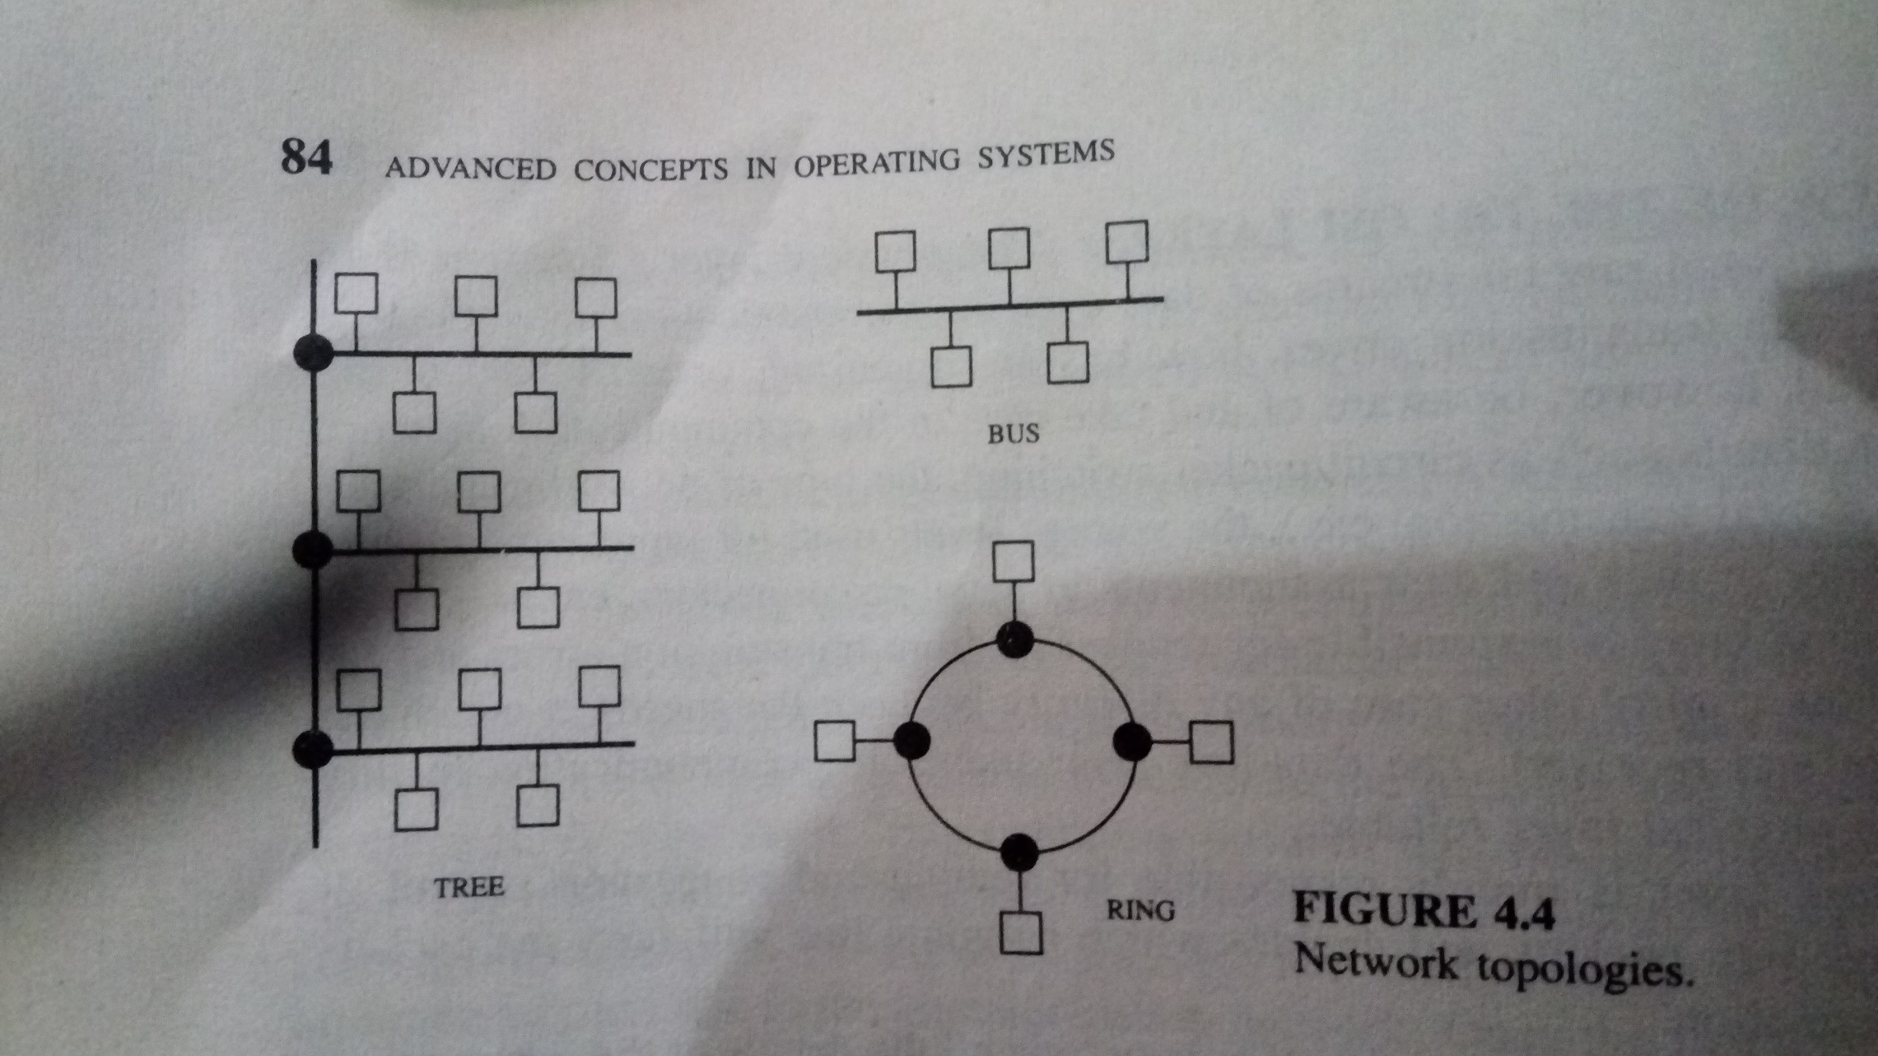

Slide 33
Communication primitives
The communication network provides a means to send and receive raw bit streams of data in distributed systems.
The communication primitives are high-level constructs with which programs use the underlying communication network.
They influence:
A programmer’s choice of algorithms
Ultimate performance of the programs.
Ease of use of the system
Efficiency of applications that are developed for the system
Communication models that provide communication primitives are,
The message passing model
Remote procedure call

Slide 34
The Message Passing Model
This model provides two basic communication primitives ,
SEND and RECEIVE.
The SEND primitive has two parameters :
a message and its destination.
The RECEIVE primitive has two parameters :
the source of the message and a buffer for storing the message.
Example: client server model
The client process needing some service sends a message to the server and waits for a reply message. After performing the task, the server process sends the result in the form of a reply message to the client process.
The SEND and RECEIVE primitives provide the basic communication ability to programs.
The semantics of these primitives also play a significant role in ease of developing programs.

Slide 35
The message passing model
In the standard message passing model, messages are copied three times:
From user buffer to the kernel buffer
From kernel buffer on the sending computer to the kernel buffer on the receiving computer.
From the kernel buffer on the receiving computer to a user buffer.
This is known as the buffered option.
The two design issues that decide the semantics of these two primitives are:
BLOCKING VS. NONBLOCKING PRIMITIVES
SYNCHRONOUS VS. ASYNCHRONOUS PRIMITIVES

Slide 36
1.BLOCKING VS. NONBLOCKING PRIMITIVES
With NONBLOCKING PRIMITIVES, the SEND primitive returns control to the user process as soon as the message is copied from the user buffer onto the kernel buffer.
The corresponding RECEIVE primitive signals its intention to receive a message and provides a buffer to copy the message. The receiving process may either periodically check for the arrival of a message or be signalled by the kernel upon arrival of a message. Here programming is difficult, but flexible.
With BLOCKING PRIMITIVES, the SEND primitive does not return control to the user program until the message has been sent or until an acknowledgement has been received. The user buffer can be reused as soon as the control is returned to the user program.
The corresponding RECEIVE primitive does not return control until a message is copied to the user buffer. A reliable RECEIVE primitive automatically sends an acknowledgement, while an unreliable RECEIVE primitive does not send an acknowledgement. Here the behavior of the programs is predictable, and programming is easy., but lack of flexibility in programming and absence of concurrency.

Slide 37
SYNCHRONOUS VS. ASYNCHRONOUS PRIMITIVES
With synchronous primitives, a SEND primitive is blocked until a corresponding RECEIVE primitive is executed at the receiving computer. Also called rendezvous. A blocking synchronous primitive can be extended to an unblocking-synchronous primitive by first copying a message to a buffer at the sending side, and then allowing the process to perform other computational except another SEND.
With asynchronous primitives, the messages are buffered. A SEND primitive does not block even if there is no corresponding execution of RECEIVE primitive.
The corresponding RECEIVE primitive can either be a blocking or a nonblocking primitive.
Disadvantage – buffering of messages is more complex and what to do with the messages that are meant for processes that have already died.

Slide 38
Remote procedure call
RPC is an interaction between a client and a server, where the client needing a service invokes a procedure at the server.
On invoking a remote procedure, the calling process (the client) is suspended and parameters, if any are passed to the remote machine(the server) where the procedure will execute.
On completion of the procedure execution, the results are passed back from the server to the client and the client resumes execution as if it had called local procedure.
While the RPC mechanism looks simple, the issues that arise in designing and implementing are,
Structure
Binding
Parameter and result passing
Error handling, semantics and correctness

Slide 39
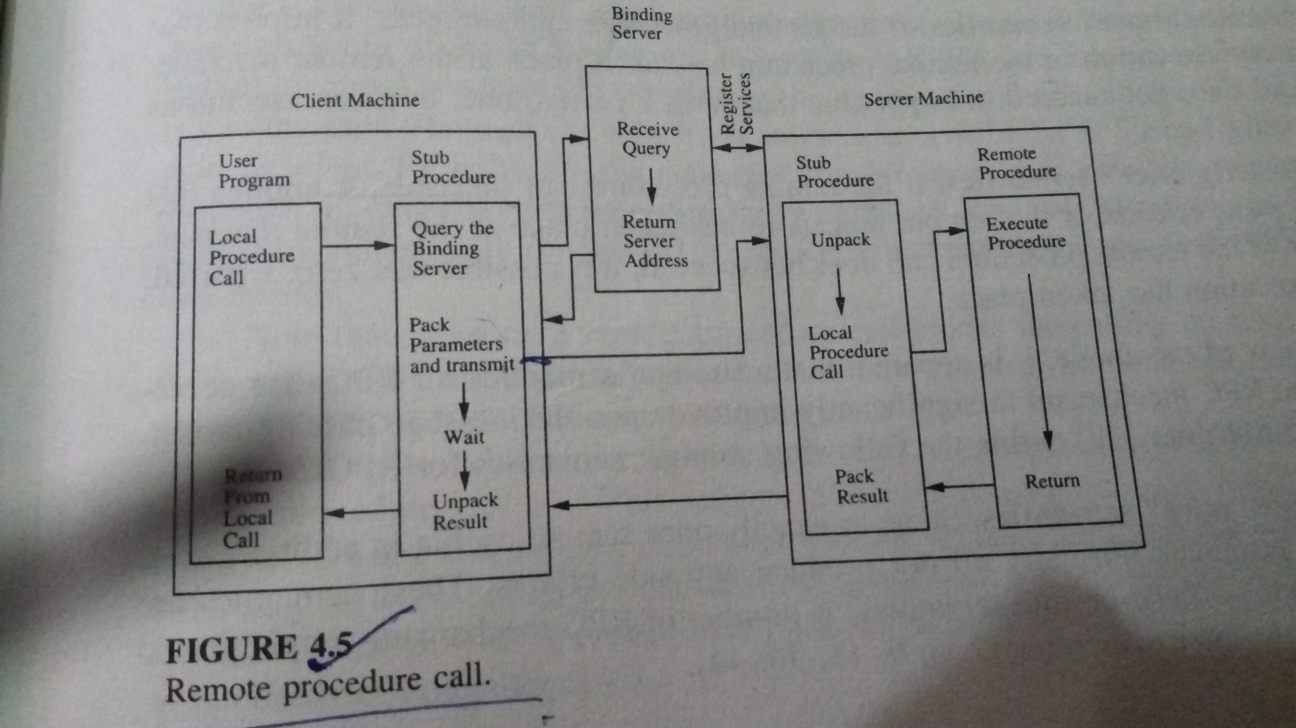

Slide 40
Design Issues in RPC
Structure
Binding
Parameter and result passing
Error handling, semantics, and correctness

Slide 41
Structure
RPC is based on stub procedures
Client stub and server stub are used
Client stub send message to server stub
Server stub procedure passes result back to client stub procedure

Slide 42
Binding
Approach 1
Binding is a process that determines the remote procedure and the machine on which it will be executed
Also check the compatibility of parameters passed and the procedure type
A binding server is used, which store the server machine addresses with the services they provide.
Servers register with binding server.
Client stub procedure obtains server address from binding server. Approach 2
Client specifies the machine and service required, binding server returns the port number for communicating with the service required

Slide 43
Parameter and result passing
Stub procedure has to convert the parameters and results into an appropriate representation and pack them to a buffer in a form suitable for transmission.
Conversion is expensive Ways to avoid conversion
Send parameters along with a code so that receiver can do conversion, this requires the machine to know how to convert all formats. If new representation is there, existing software needs to be updated.
Each data type may have a standard format, sender will convert data to standard format, receiver will convert to local representation.
Dealing with passing parameters by value and by reference. Passing by value is easy, but by reference is complicated because along with file pointers previleges associated with calling procedure have to be passed.

Slide 44
Error handling, semantics and correctness
RPC may fail due to computer failures and communication failures
Messages lost occasionally, result in more than one execution of procedure call.
Client machine crashes, then no machine to receive result. If client machine recovers quickly and reissues RPC, results in more than one execution of procedure call.
Semantics of RPC
“At least once” semantics
“Exactly once” semantics Stronger semantics
“At most once” semantics ("Zero-or-one” semantics)

